Slide 1


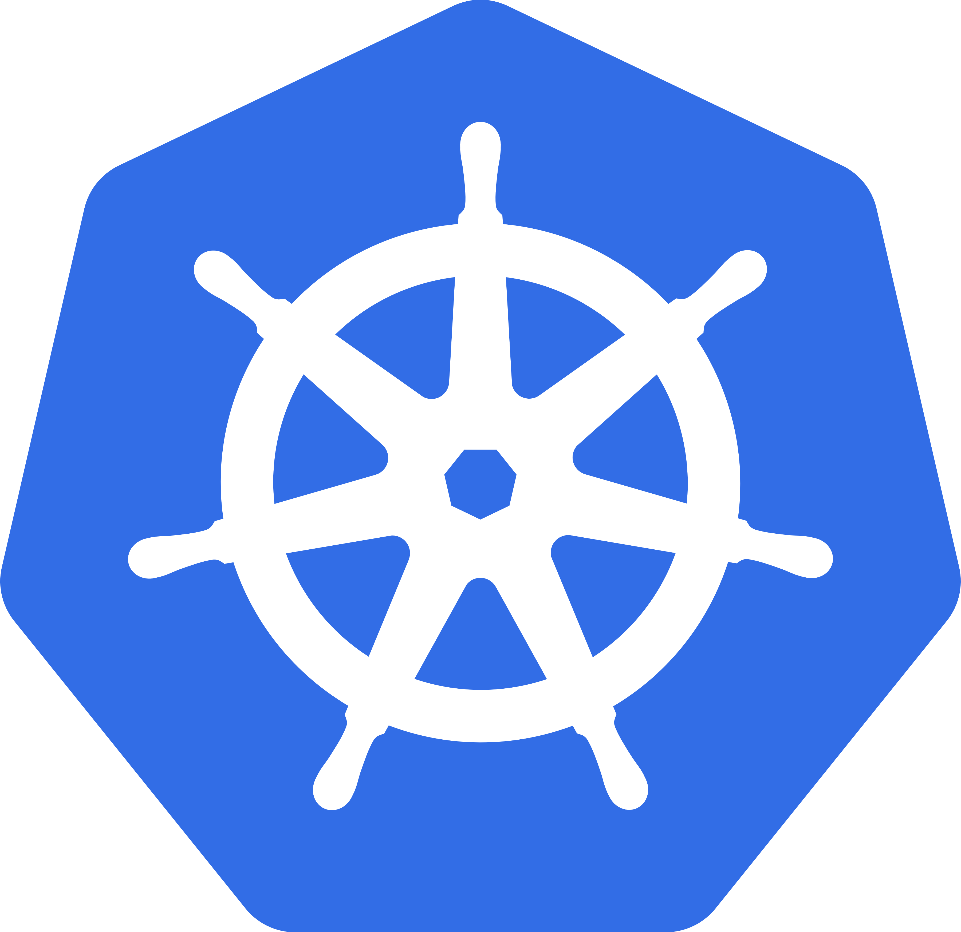

Presented by:
MA067
TANK RAJNIKUMAR
MA075
VALAKI JAYMIN

Slide 2
AGENDA 1
Architecture? And it’s types.
What is Monolith?
Pros and Cons of Monolithic Architecture
Problem with NETFLIX
From Monolithic to Multi server
Container?
Docker vs Kubernetes

Slide 3
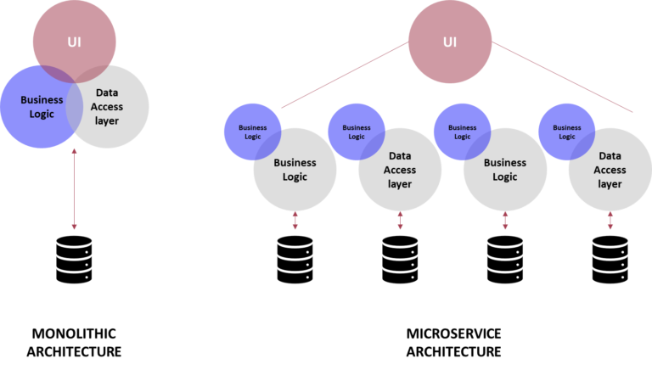
ARCHITECHURE & IT’s TYPES
The architecture reflects how the system application is used and how it interacts with other systems and the outside world.
TYPES OF ARCHITECHURE
1)MONOLYTH ARCHITECHURE
2)MULTI SERVICE ARCHITECHURE

Slide 4
Monolith
Traditional model of a software program
built as a unified unit
self-contained and independent from other applications
singular, large computing network
To make a change of application requires updating the entire stack
building and deploying an updated version of the service-side interface

Slide 5
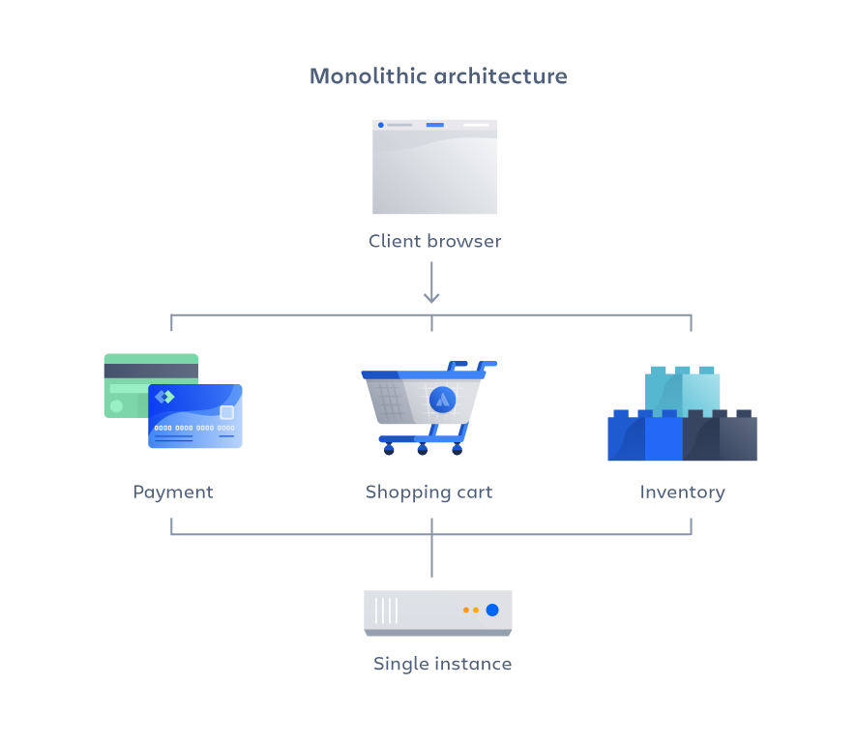
Example of Monolithic Architecture

Slide 6
Advantages of a Monolithic Architecture
Easy deployment
Easy to develop
Simplified testing
Easy debugging

Slide 7

Limitations of a Monolithic Architecture
Slower development speed
Scalability & Reliability
Lack of flexibility
“One application on one server”

Slide 8
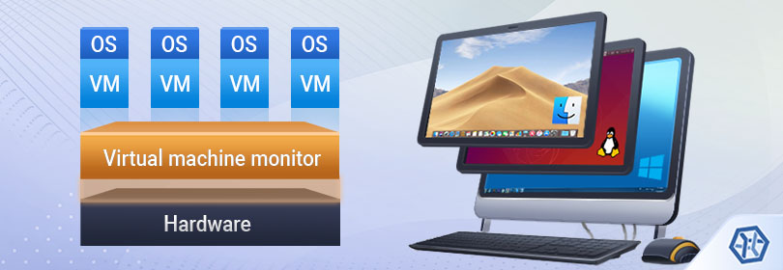
VIRTUAL MACHINE
IN 1997 VM VARE COMPANY DEVELPED A CONCEPT OF VIRTUAL MACHINE

Slide 9
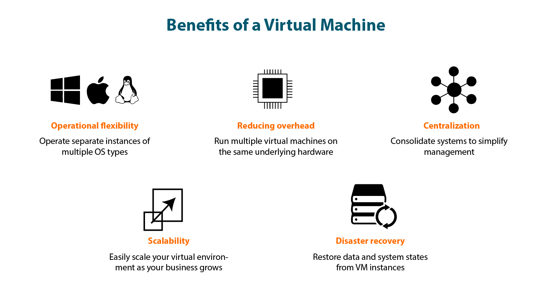
PROS & CONS OF VIRTUAL MACHINE
WE CAN RUN MULTIPLE APPLICATION
ON VIRTUAL MACHINE SO IT CAN
EASILY SOLVE PROBLEM OF
“ONE SERVER MANY SERVICES”

Slide 10
CONS OF VIRTUAL MACHINE
IT NEED SPECIFIC CPU AND RAM ALLOCATION FOR DIFFERENT APPLICATION SO IT CAN MAKE SYSTEM SLOWER.
IT CAN NOT SOLVE LATEST PROBLEM OF MODULE SHARING FROM ONE PC TO OTHER (FRIEND’S PC).

Slide 11
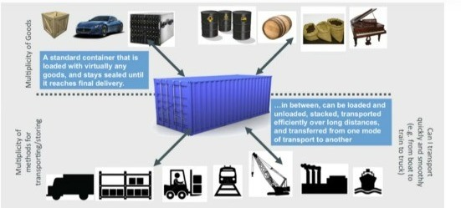
CONTAINERS – MICRO SERVISE SYSTEM
Containers are an excellent example of micro services architecture as they allow businesses to focus on developing services without worrying about dependencies

Slide 12

Problem with NETFLIX
In 2009 Netflix faced growing pains
infrastructure couldn’t keep up with the demand
private data centers to a public cloud
2015 JAX Special Jury award
Today, Netflix has more than a thousand micro-services

Slide 13
AGENDA
Answer of Previous question?
What is containerization?
Virtualization vs Containerization
Feature of containerization
Different Vendors
Docker vs Kubernetes
Architecture of Kubernetes

Slide 14
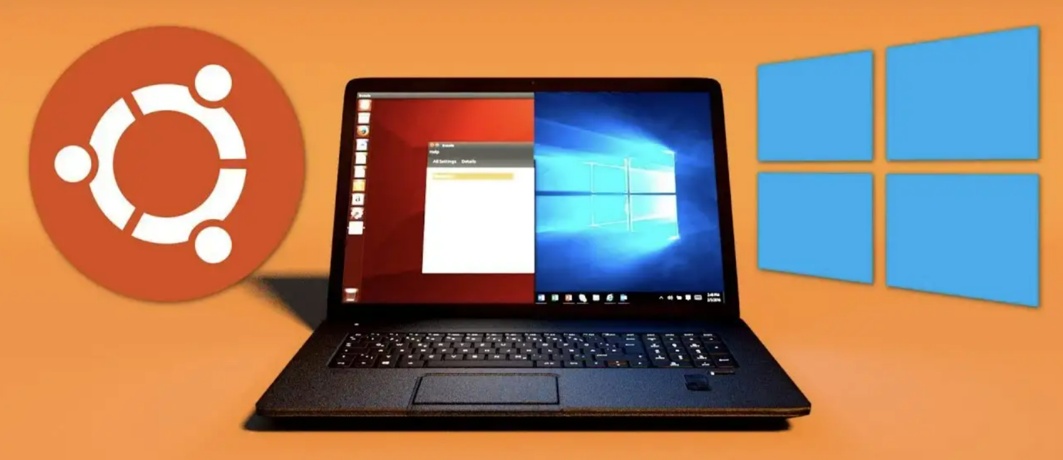
DUAL BOOT VS VIRTUAL MACHINE

Slide 15
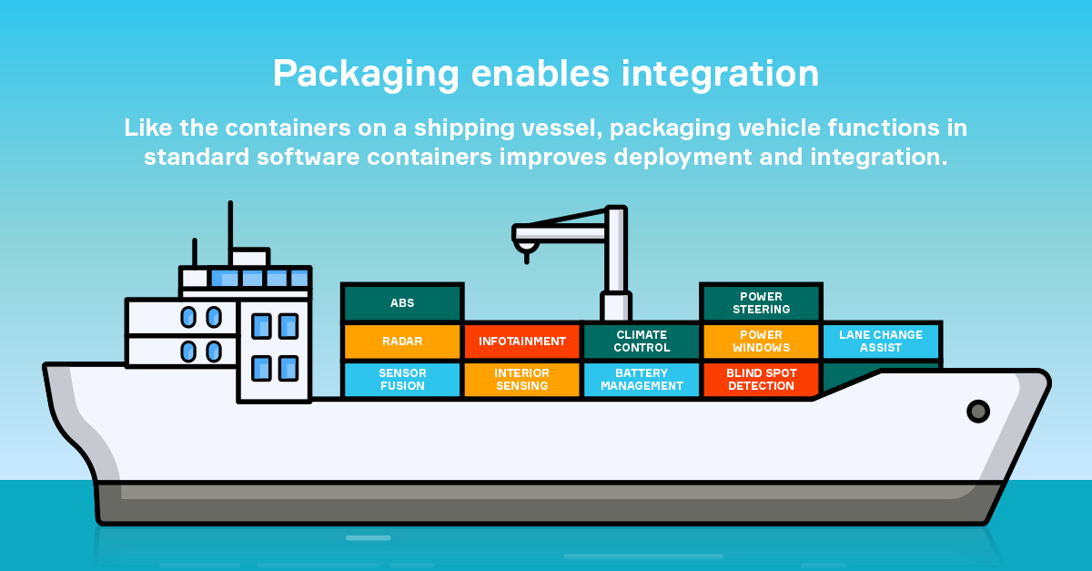
CONTAINERIZATION
What are the containers ?
Containers are a form of operating system virtualization. A single container might be used to run anything from a small micro service or software process to a larger application.
Inside a container there are
Necessary executables binary
code libraries and
configuration files.

Slide 16
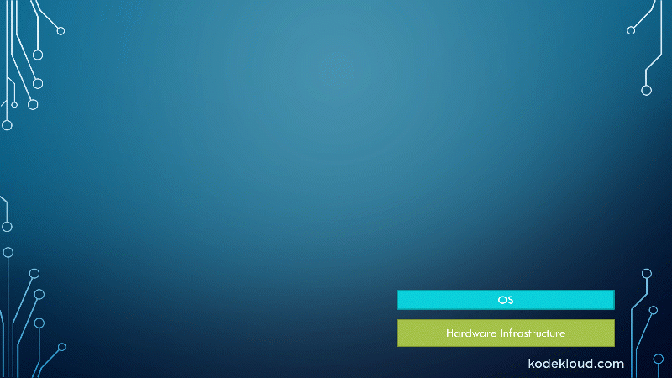
Virtualization vs Containerization
Each VM runs its own Operating system | All Container Share same OS of the host system
Boot up time required it is in limit | Container Initiate in second .
It is Not version controlled. | Docker containers work just like GIT , allowing you to a commit changes to your Docker images version control them.
.

Slide 17

Feature Of container
FLEXIBLE
No matter the complexity, the dependencies, the languages, every application can be containerized.
LIGHTWEIGHT
By sharing the same kernel, they don’t consume a lot of system resources, so you save money, which is always a good thing.
Portable
You can build locally, then run everywhere where Container is installed.
SCALABLE
Indeed you can easily increase/decrease/automatically distribute containers replicas.
You can also use an tool, like Docker Swarm, or Kubernetes.

Slide 18
DIFFERENT VENDORS
10 Tech Companies Embracing Container Technology
DOCKER
KUBERNETS
AMAZON WEB SERVICES
DIGITAL OCEAN
FUZE and many more

Slide 19
AGENDA
Continue.... Docker vs Kubernetes
What is Docker?
Architecture of Docker
History of Kubernetes
What is Kubernetes?
Architecture of Kubernetes

Slide 20
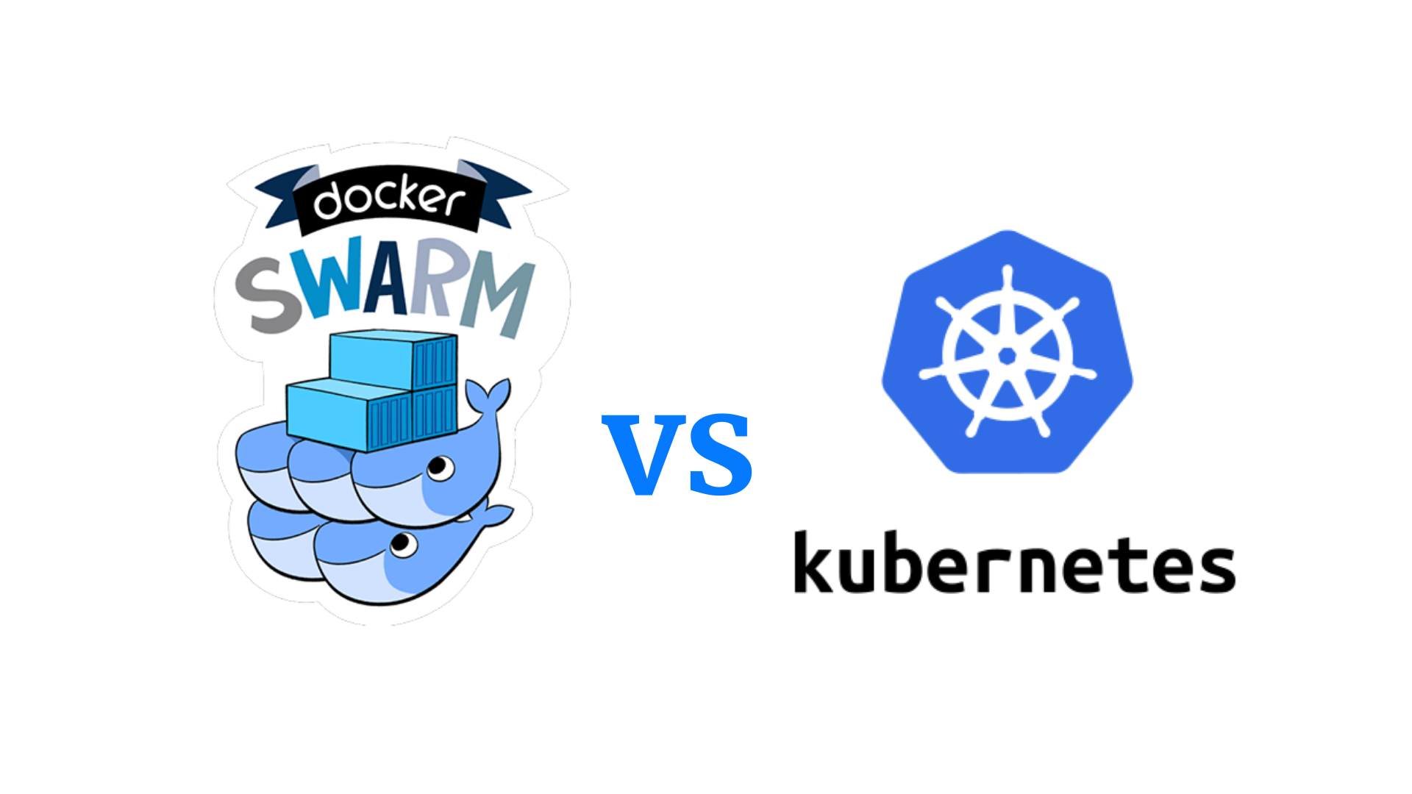
DOCKER VS KUBERNETS

Slide 21
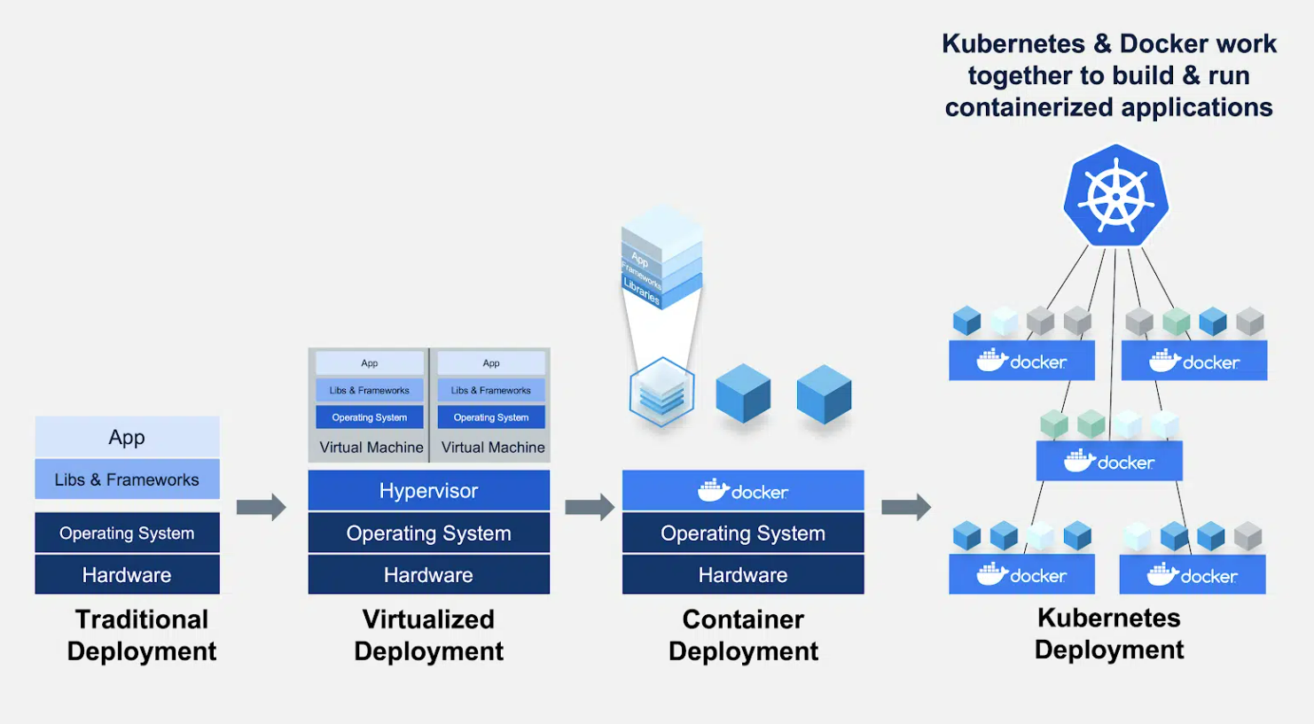

Slide 22
FEATURES | DOCKER | KUBERNETES
CONFIGURATION | Installation is simple; but once setup, the clusters is not very strong. | Installation is complicated; but once setup, the clusters is very strong
GUI | There is no GUI | GUI is the Kubernetes Dashboard
SCALABILITY | Highly scalable (almost 5x than kubernetes) | Scalable
DATA VOLUMES | Can share storage volumes with any other containers | Can share storage volumes only with other containers in same pod
Logging & Monitoring | 3rd party tools like ELK should be used for logging and monitoring | In – built tools for logging and monitoring

Slide 23
What is Docker?
A container platform
Allows you to build, test and deploy applications quickly.
A developer defines all the applications and it’s dependencies in a Dockerfile.
then used to build Docker images that defines a Docker container.

Slide 24
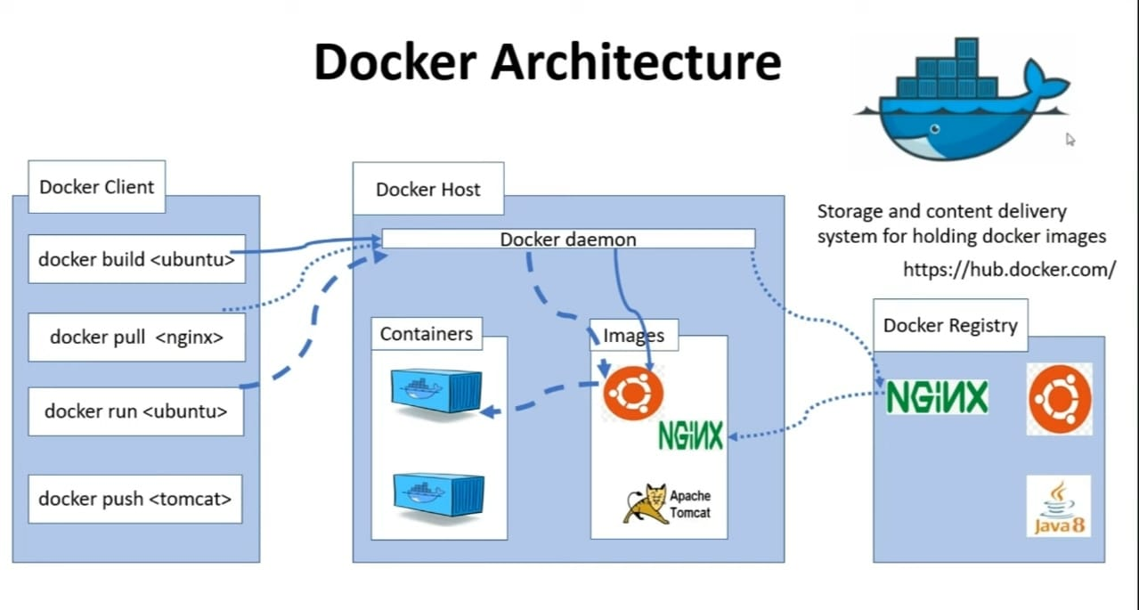
Architecture of Docker

Slide 25

Architecture of Docker

Slide 26
History of Kubernetes
AWS Offer Cloud
GOOGLE ‘s orchestration
Borg
Omega
Google – made K8s Open Source in 2014
Donated to CNCF

Slide 27
AGENDA
What’s the problem that Docker or kubernetes solve ?
What is Docker and it’s components?
Docker File
Docker image
Docker Container
Docker Command
Docker demo

Slide 28


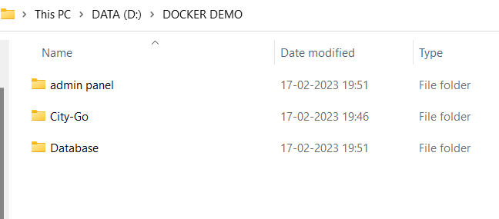

Slide 29



SHARE CITY GO SITE
FRIEND 1
HOW MANY WAYS TO SHARE SITE
1)USE OF PENDRIVE
2)USE GITHUB LIKE TOOLS
3)USE CONTAINERIZATION
MR SHARMA
FRIEND 2

Slide 30
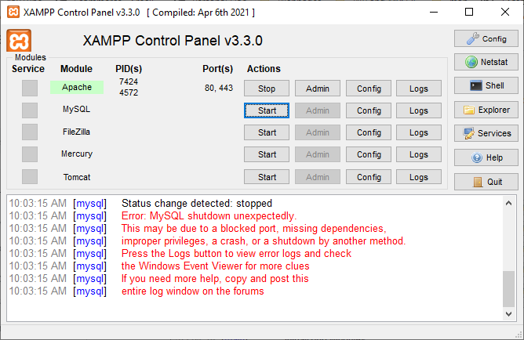

What Are The Issue That Friends Face ?

Slide 31
We can solve this issue by Containerization

Slide 32
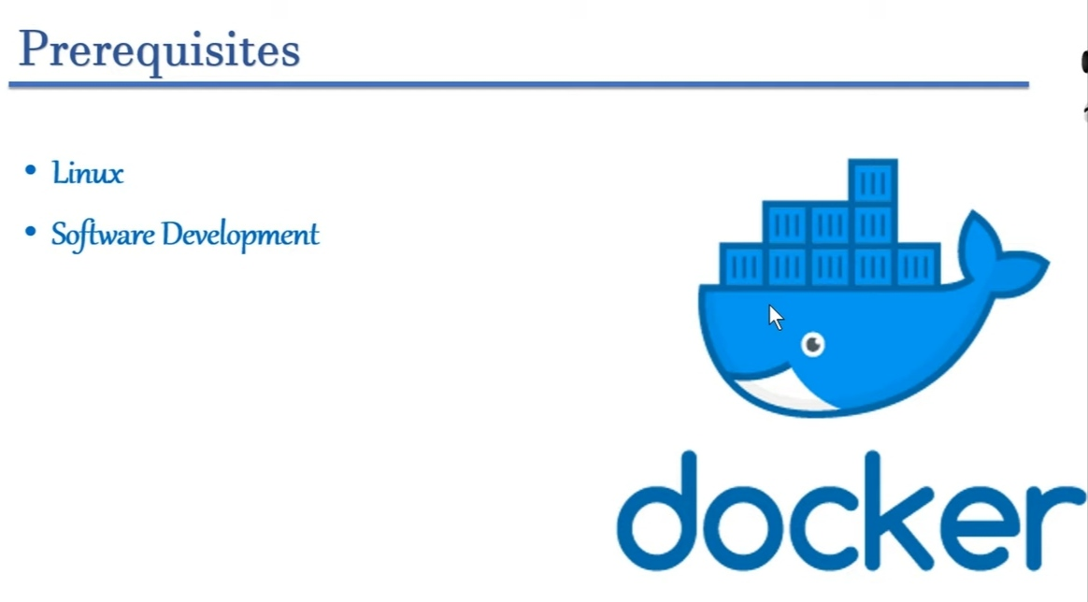

Slide 33
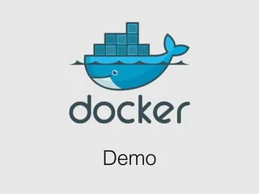
Docker Demo
Let’s start with demo and
some important keywords and
commands to understand Docker properly.

Slide 34
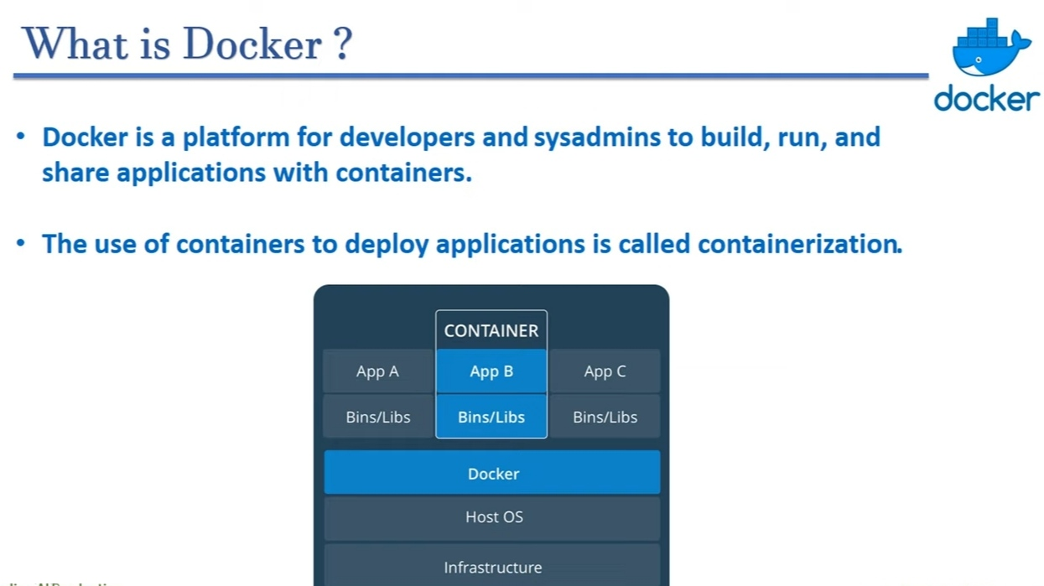

Slide 35
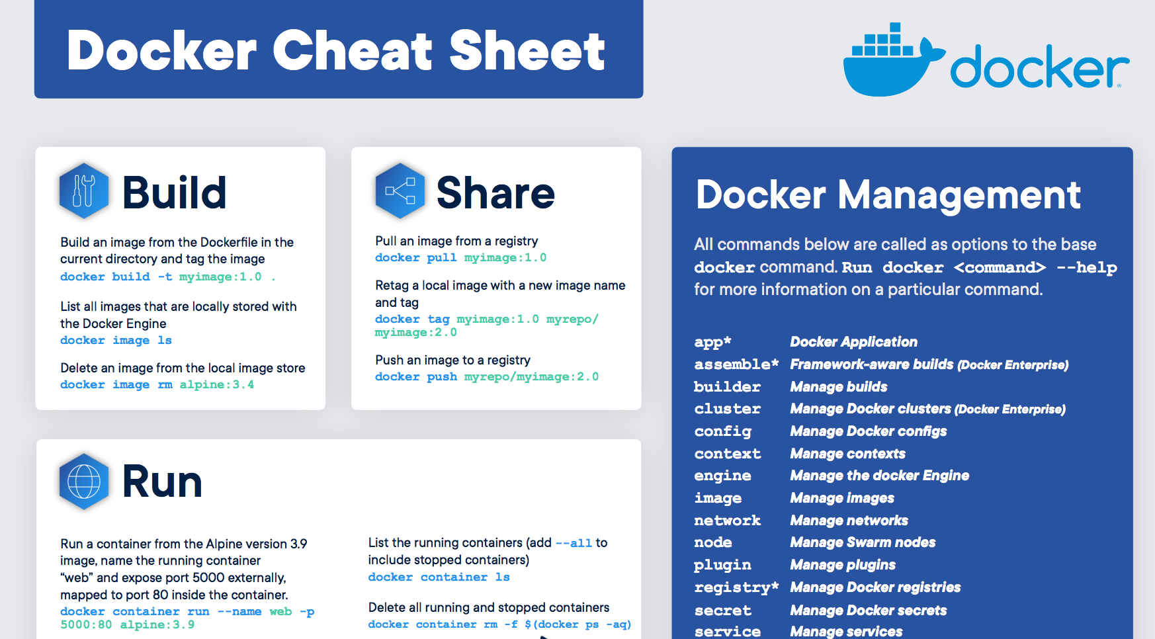
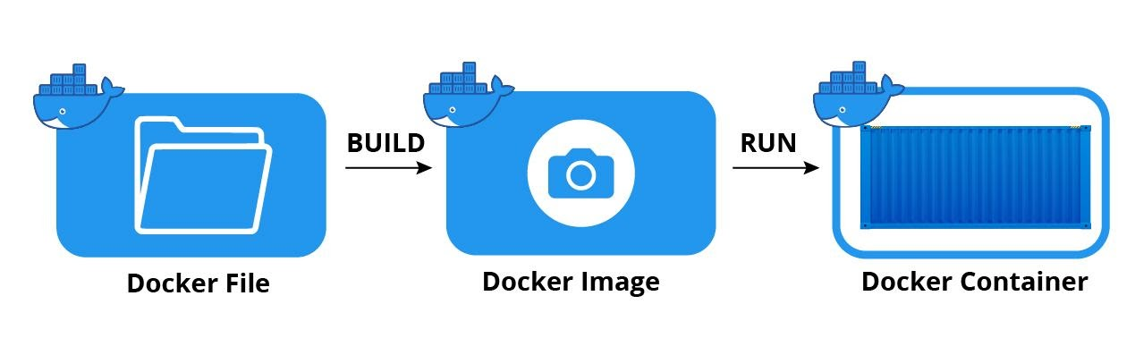
Important keywords related to Docker:
Dockerfile: A text file that contains instructions for building a Docker image.
Docker image: A lightweight executable package that includes everything needed to run a piece of software, including code, libraries & dependencies.
Container: An instance of a Docker image that can be run, started, stopped, moved, and deleted.

Slide 36
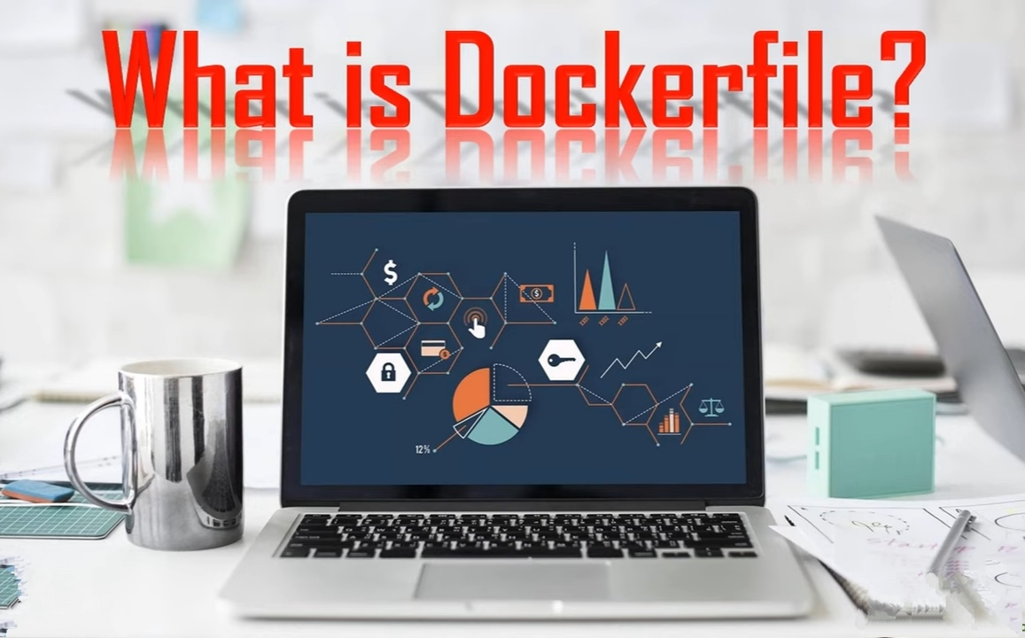

Slide 37
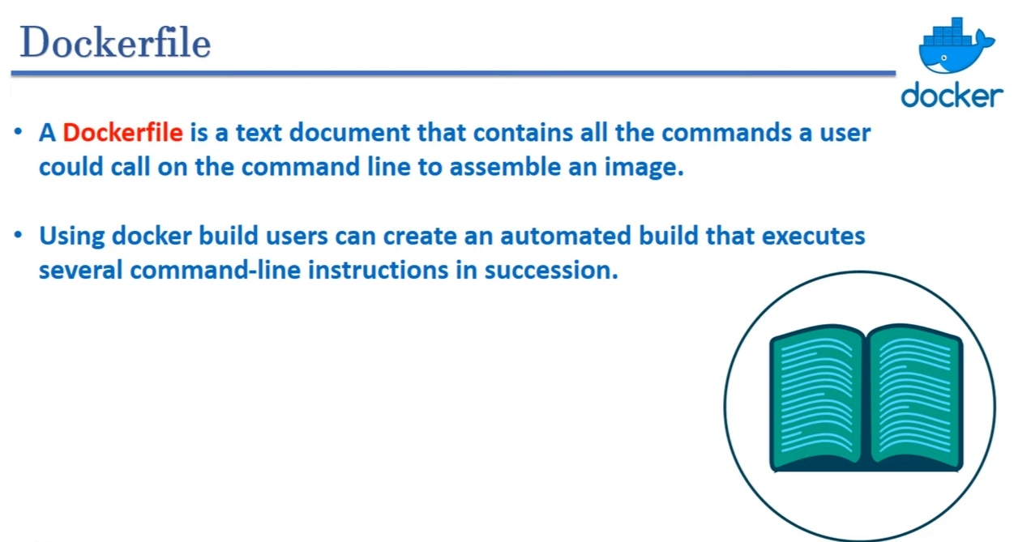

Slide 38
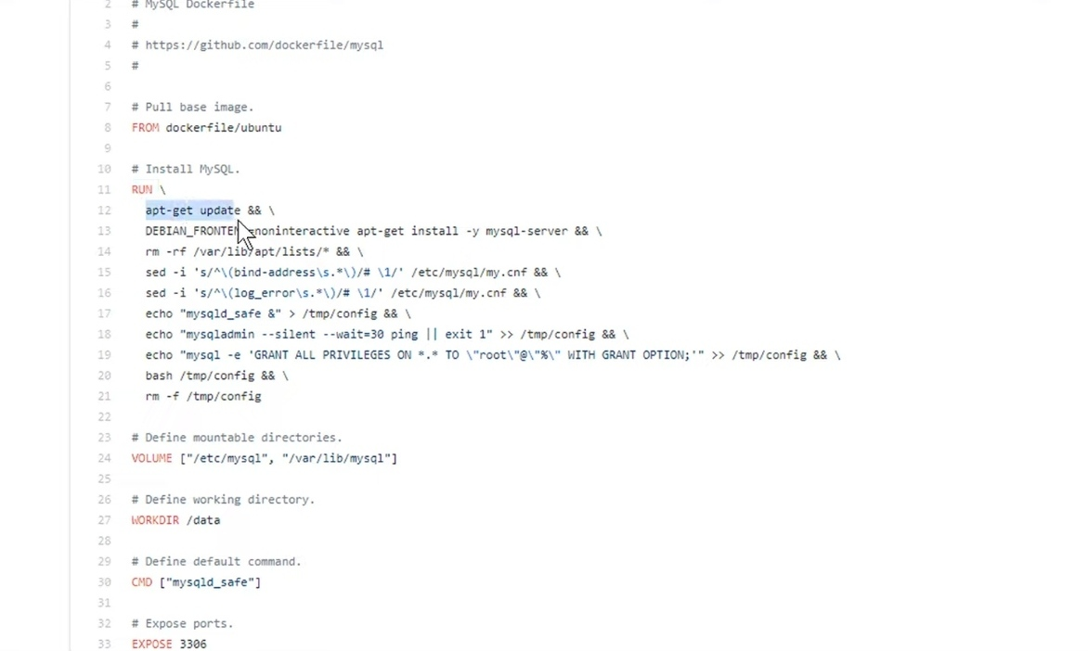
https://github.com/docker-library/mysql

Slide 39
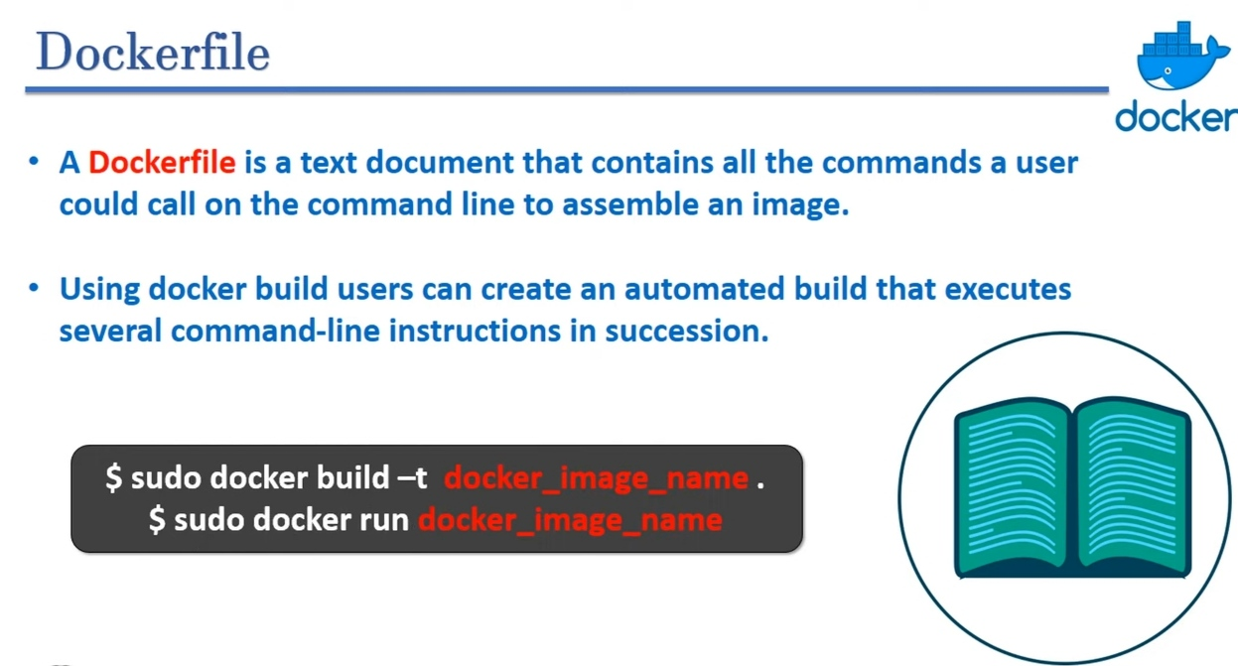

Slide 40
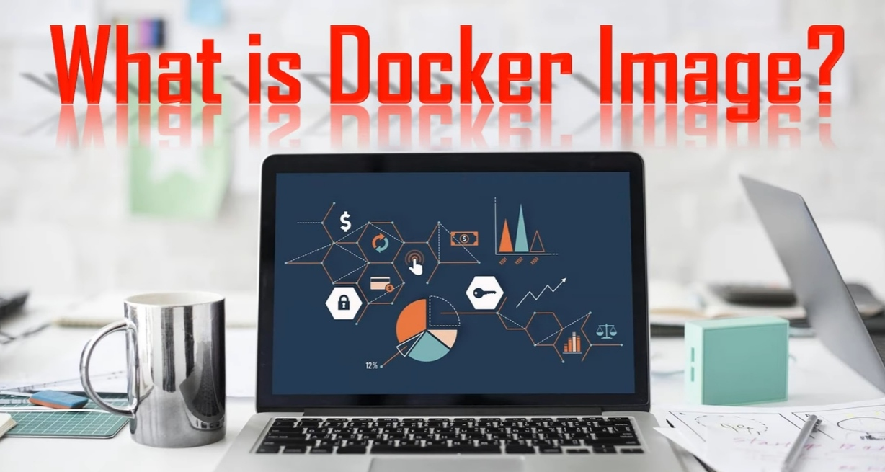

Slide 41
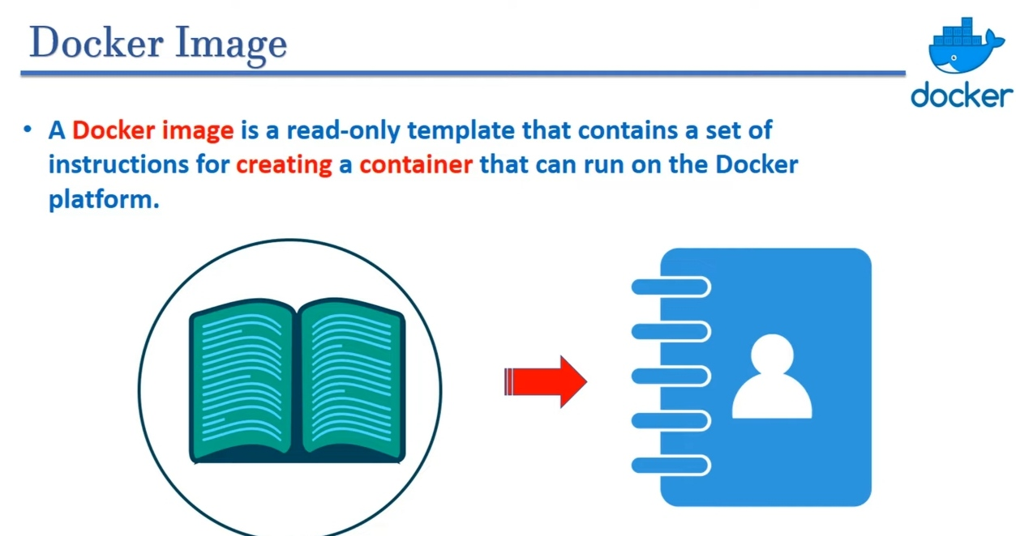

Slide 42
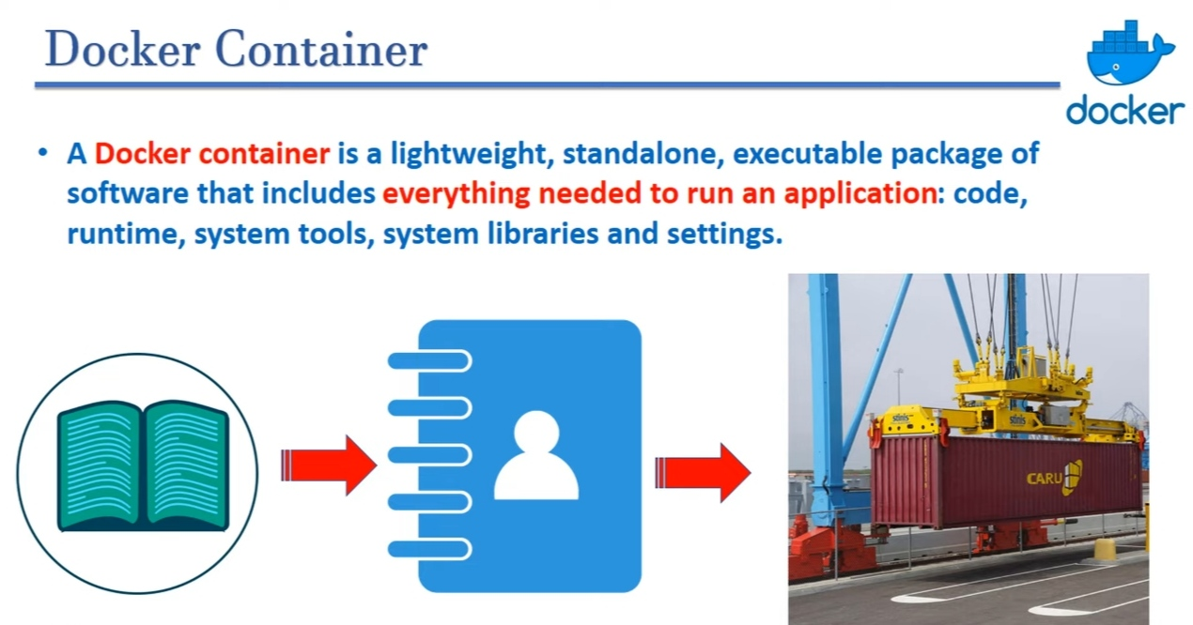

Slide 43
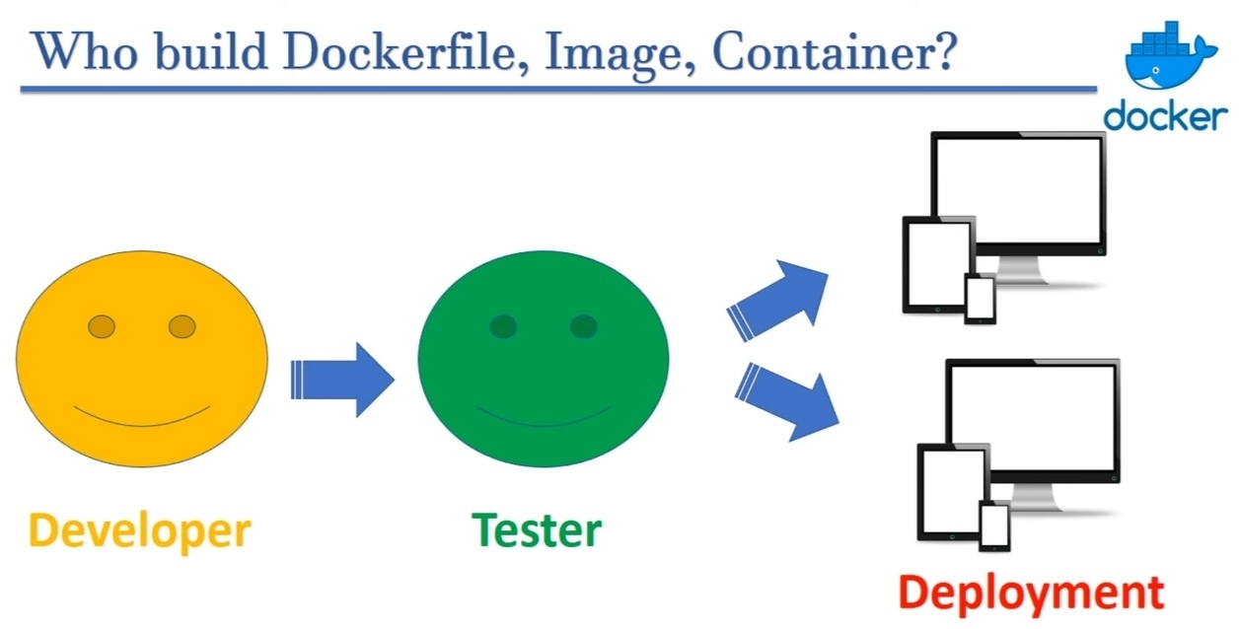

Slide 44
DOCKER COMMANDS

Slide 47
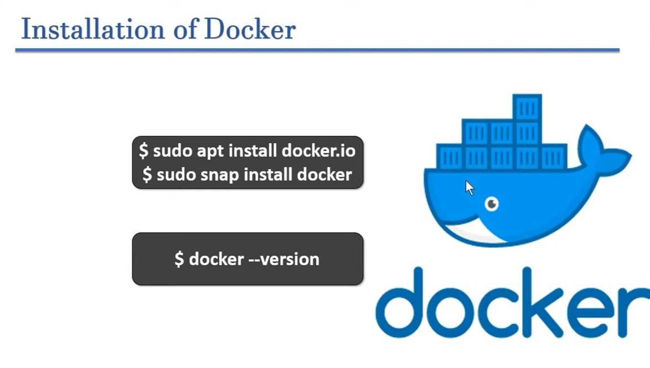

Slide 49
Live Demo of Docker Commands
How the Docker-file Actually looks?
Custom image build command
Image list command
How to remove Image
Create a container

Slide 50
Docker Image Command

Slide 51
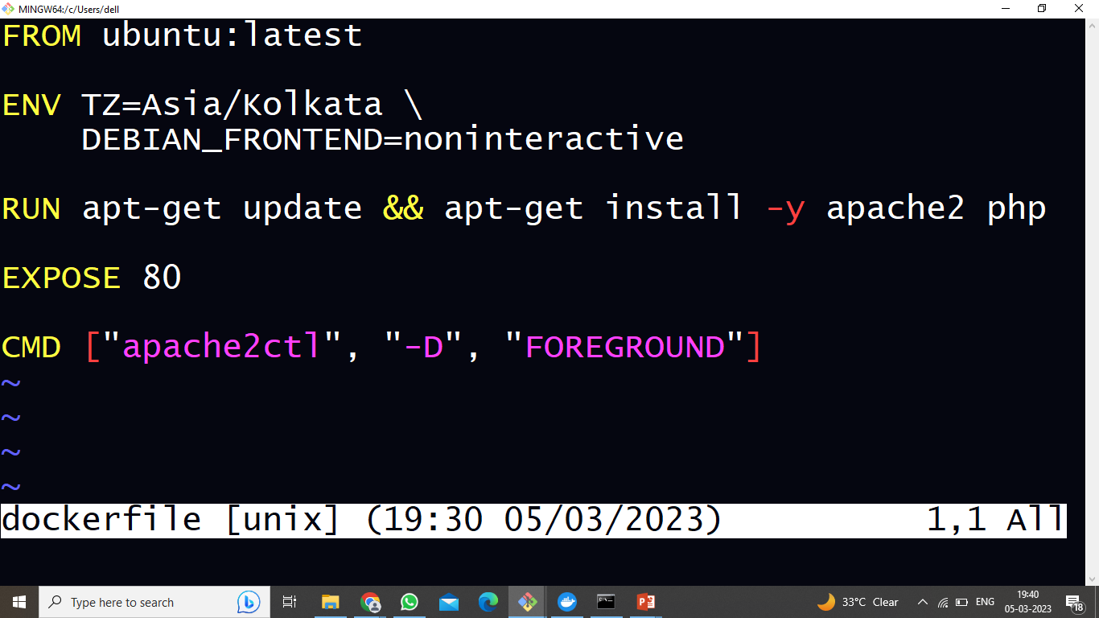
How the Docker-file Actually looks?

Slide 52
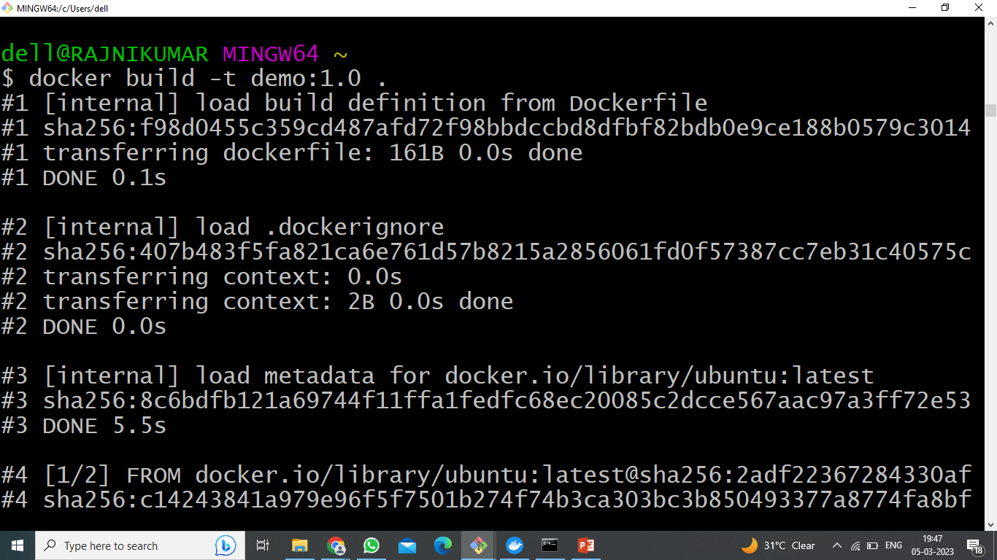
Custom image build command

Slide 53
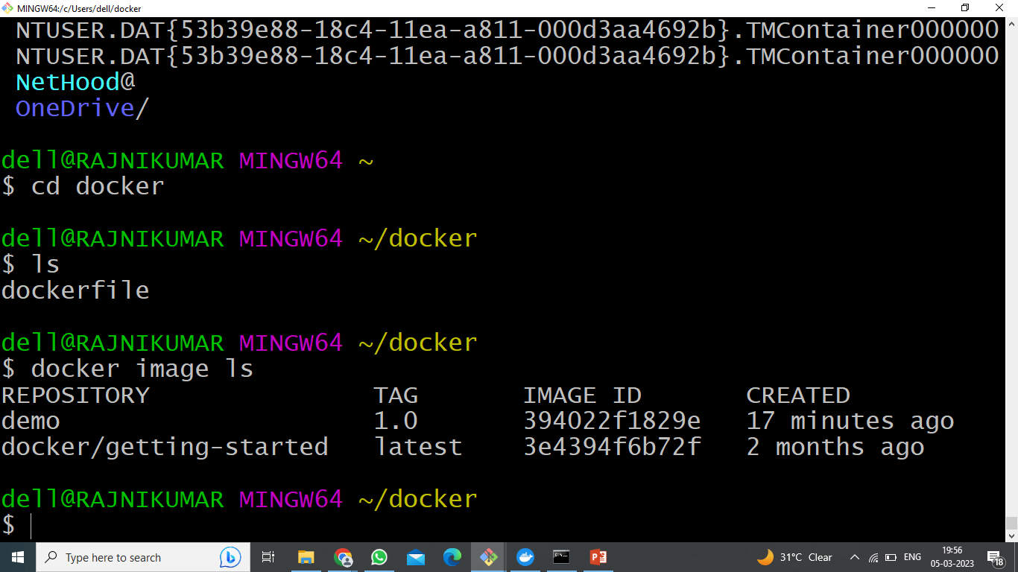
Image list command

Slide 54
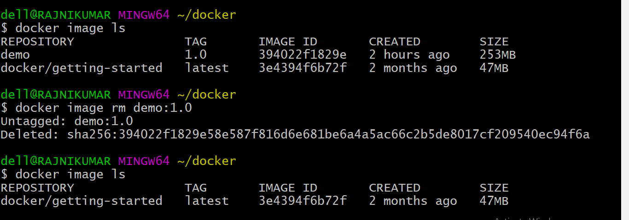
How to remove Image?

Slide 55
Docker Container Command

Slide 56
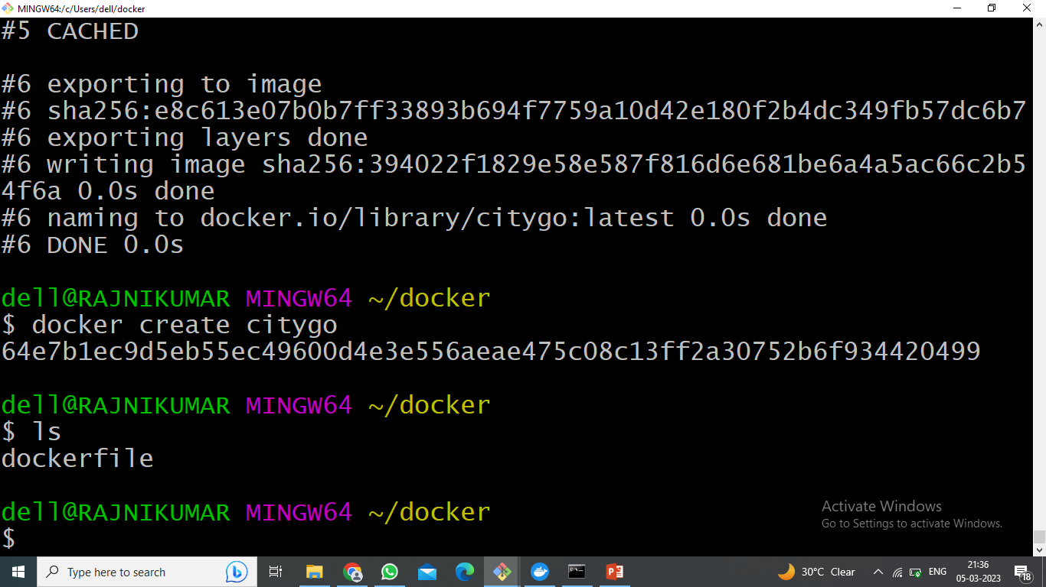
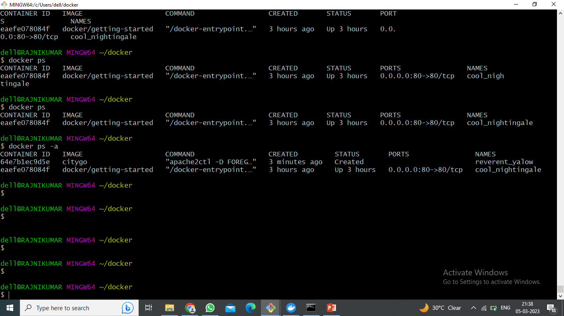
Create a container

Slide 57
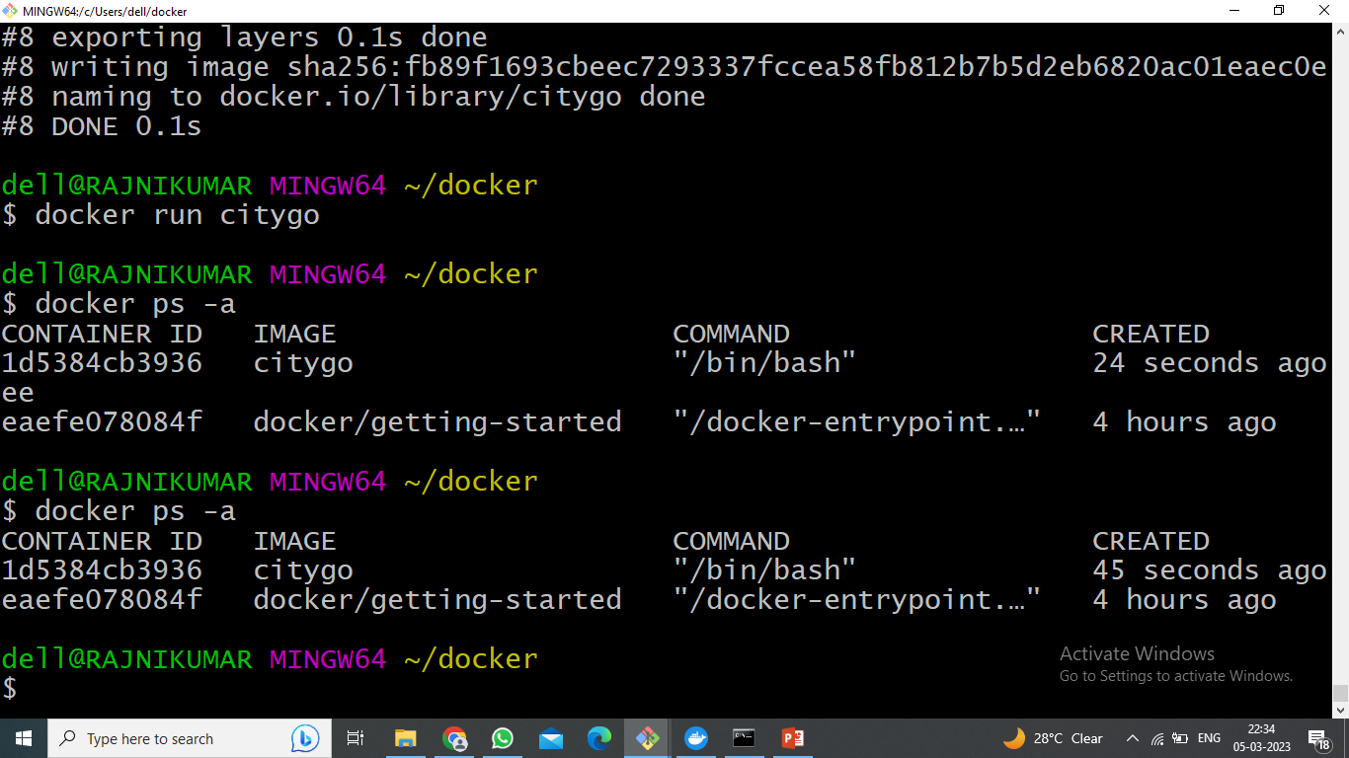
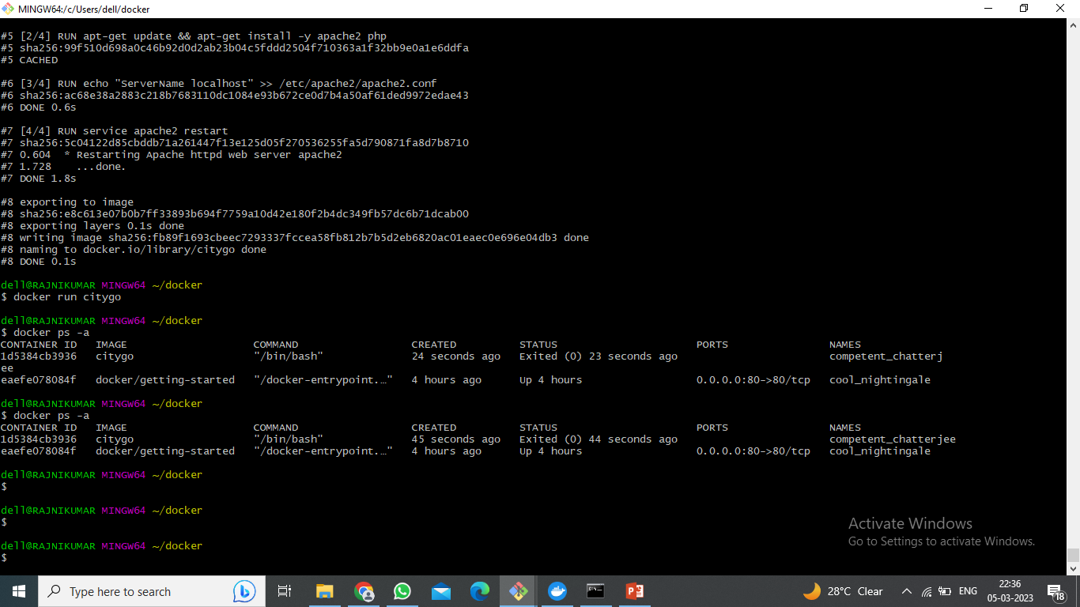
Run a command in new container

Slide 58
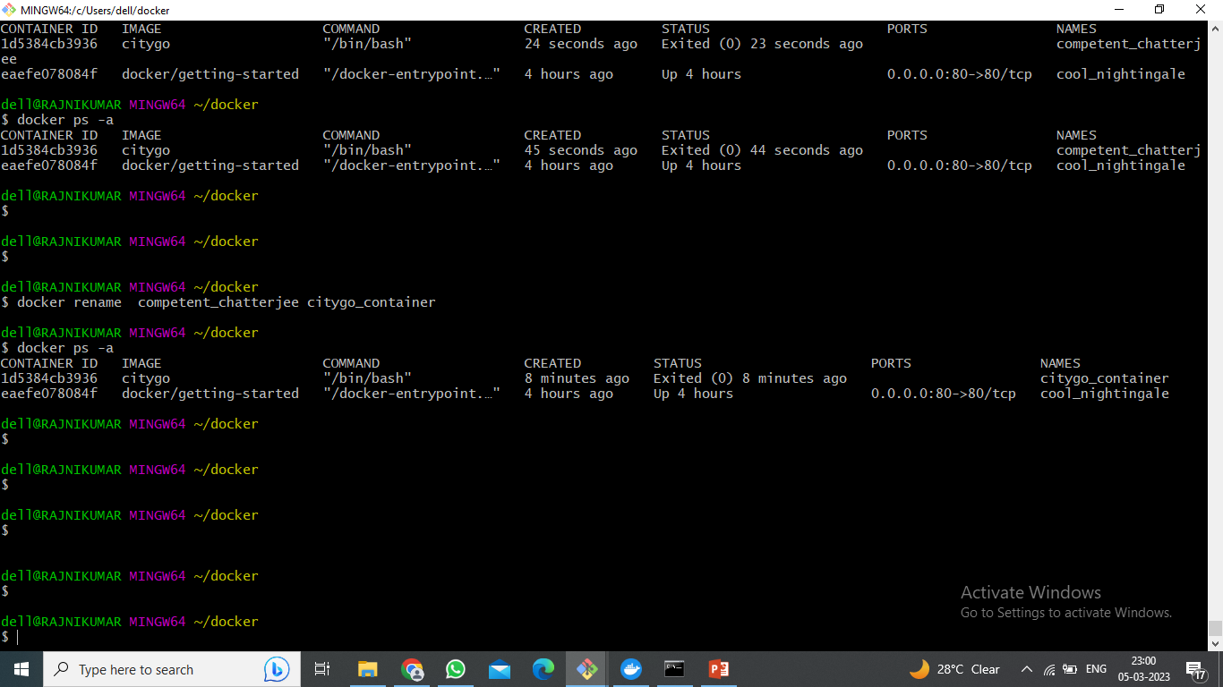
Rename an existing container

Slide 59
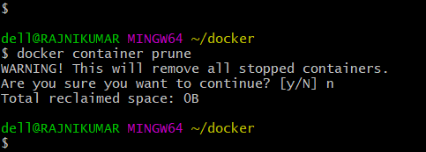
Remove all stopped Containers

Slide 60
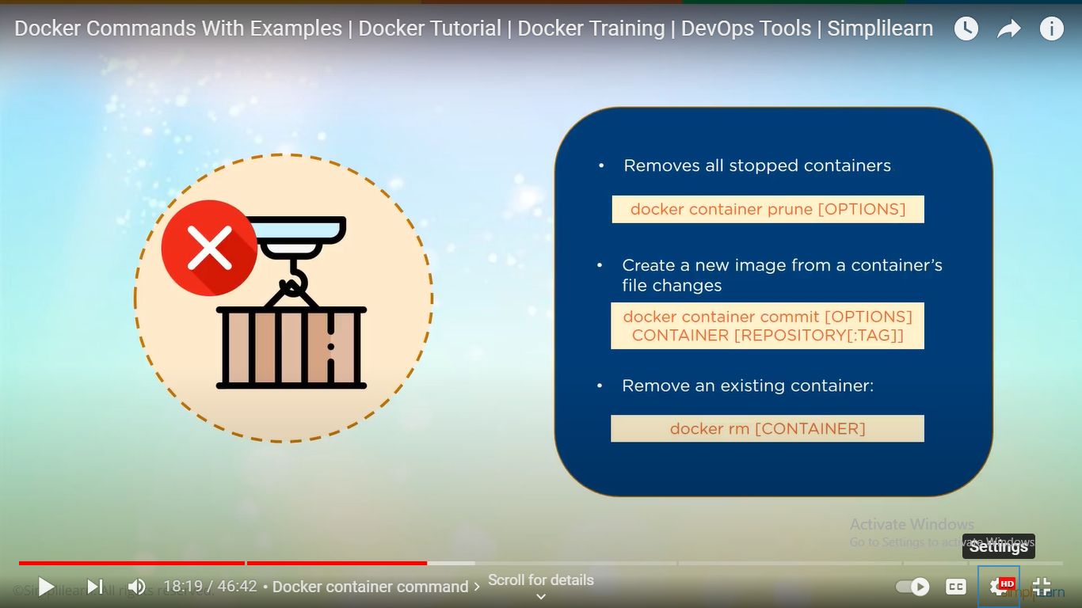
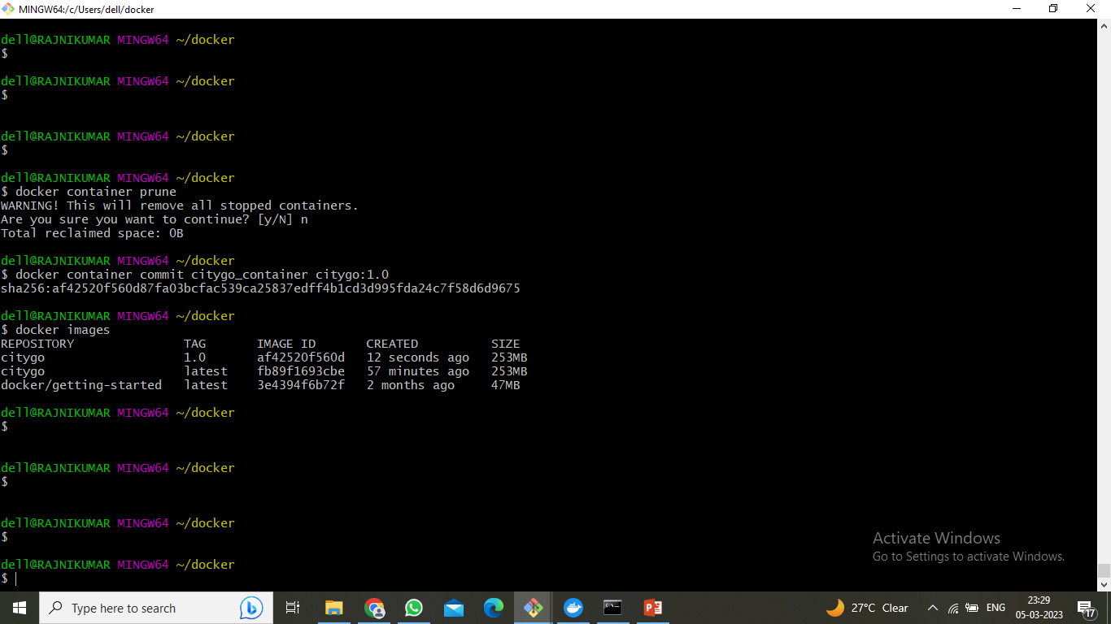
Create a new image from a container’s files change

Slide 61
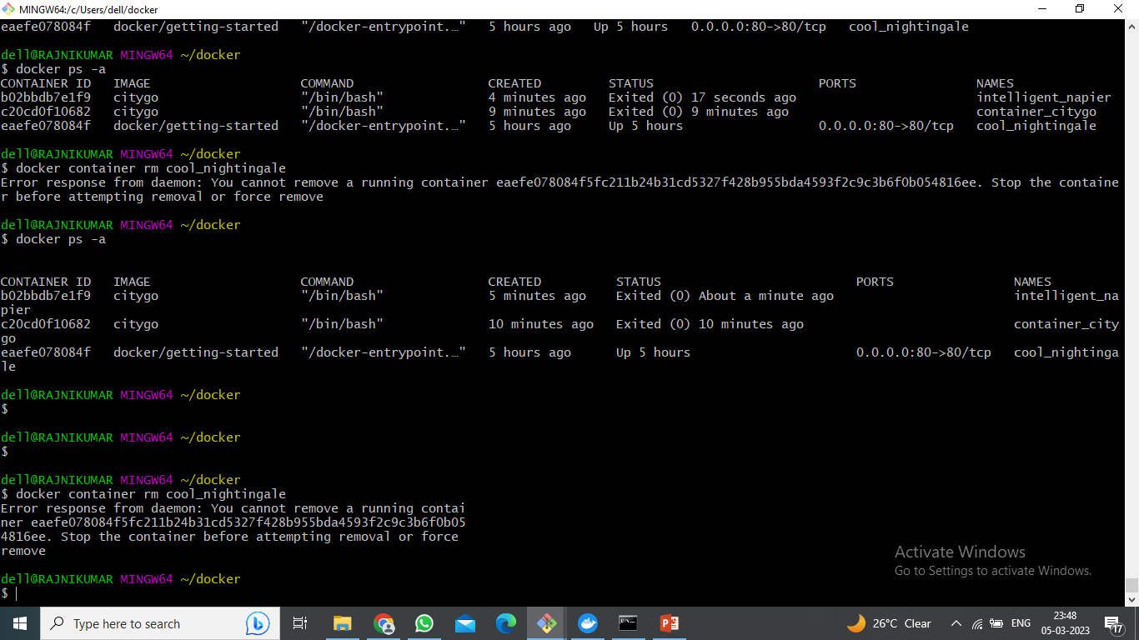
Remove Container

Slide 62
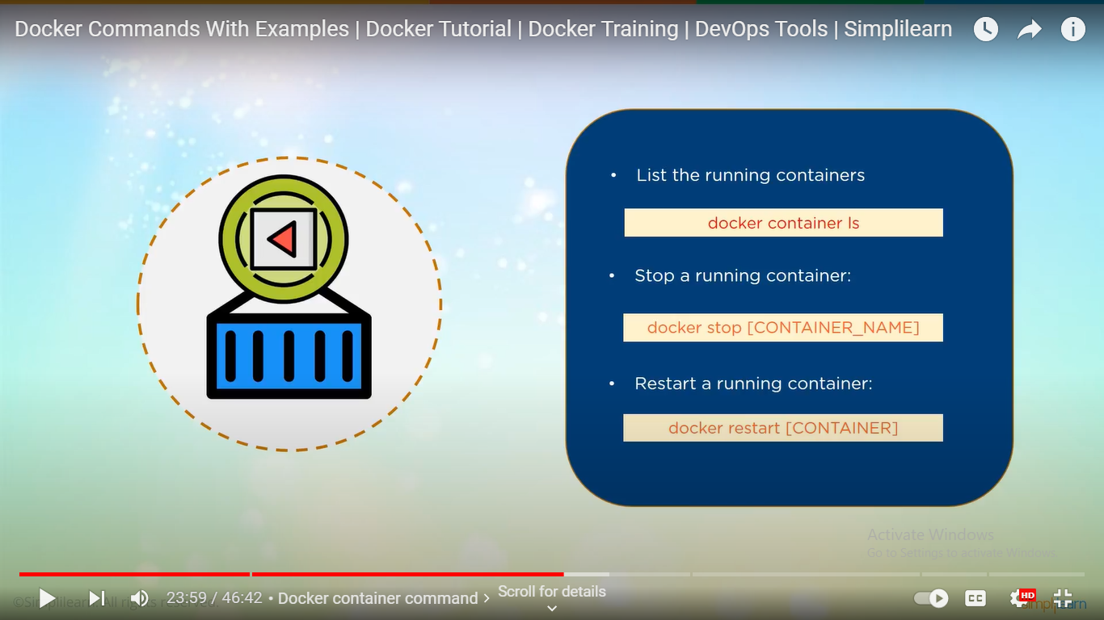
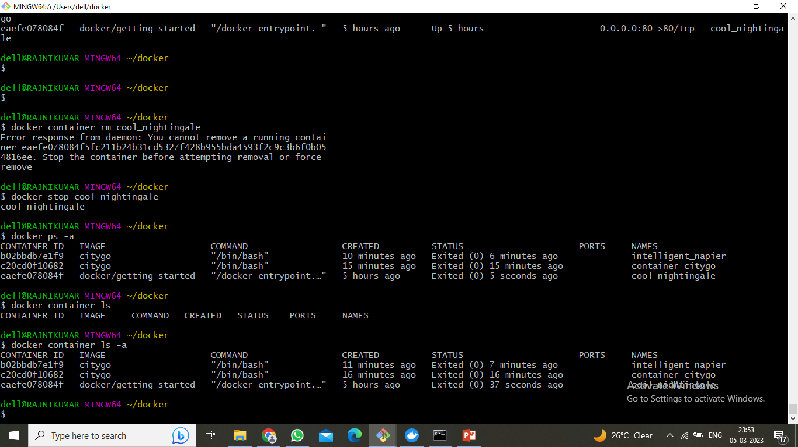
Container stop command

Slide 63

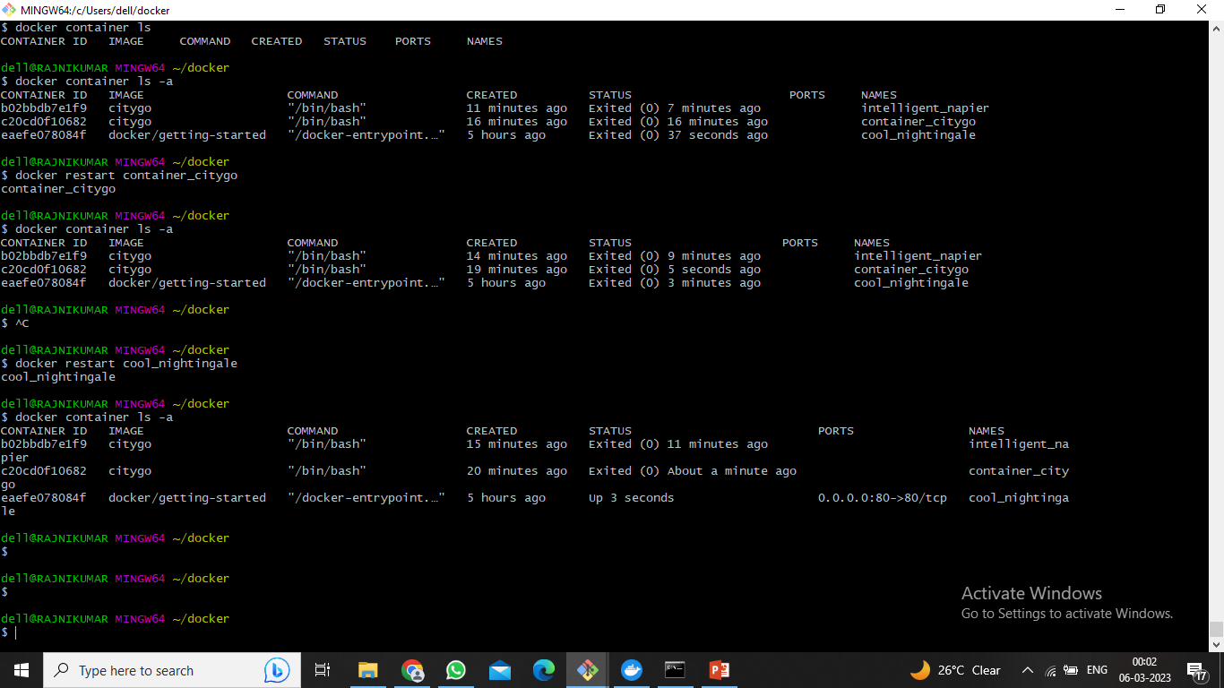
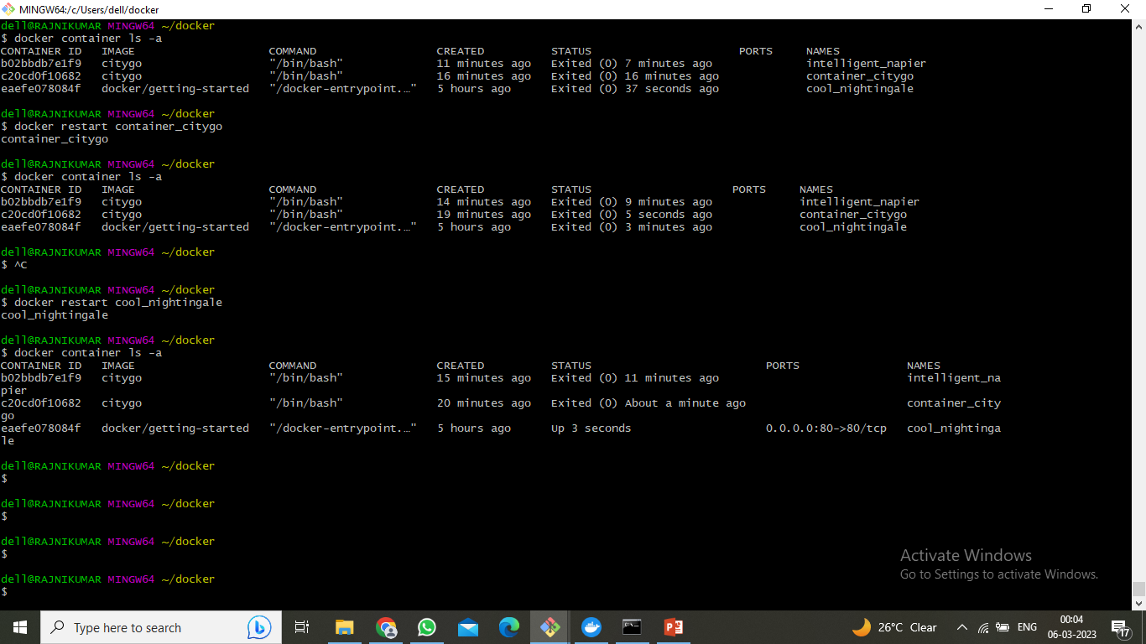
Restart container

Slide 64
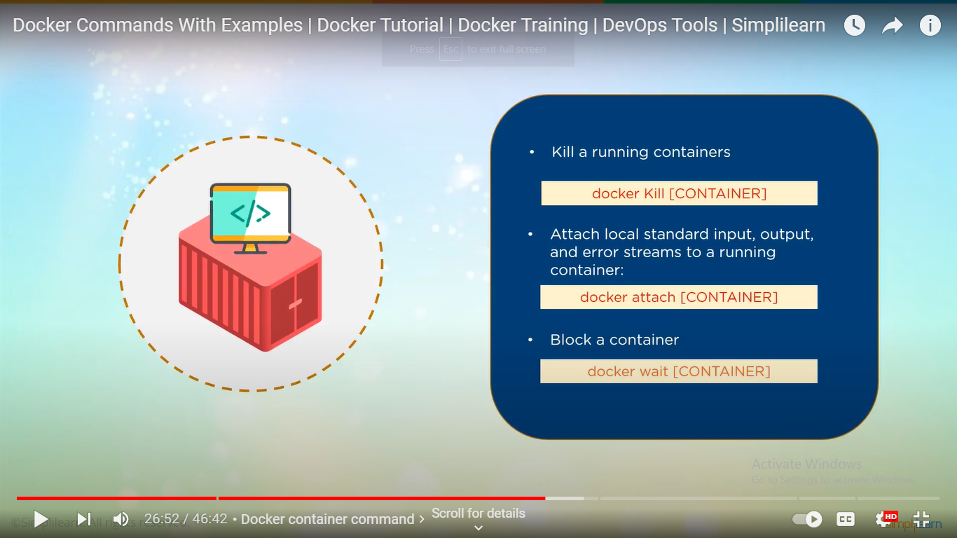
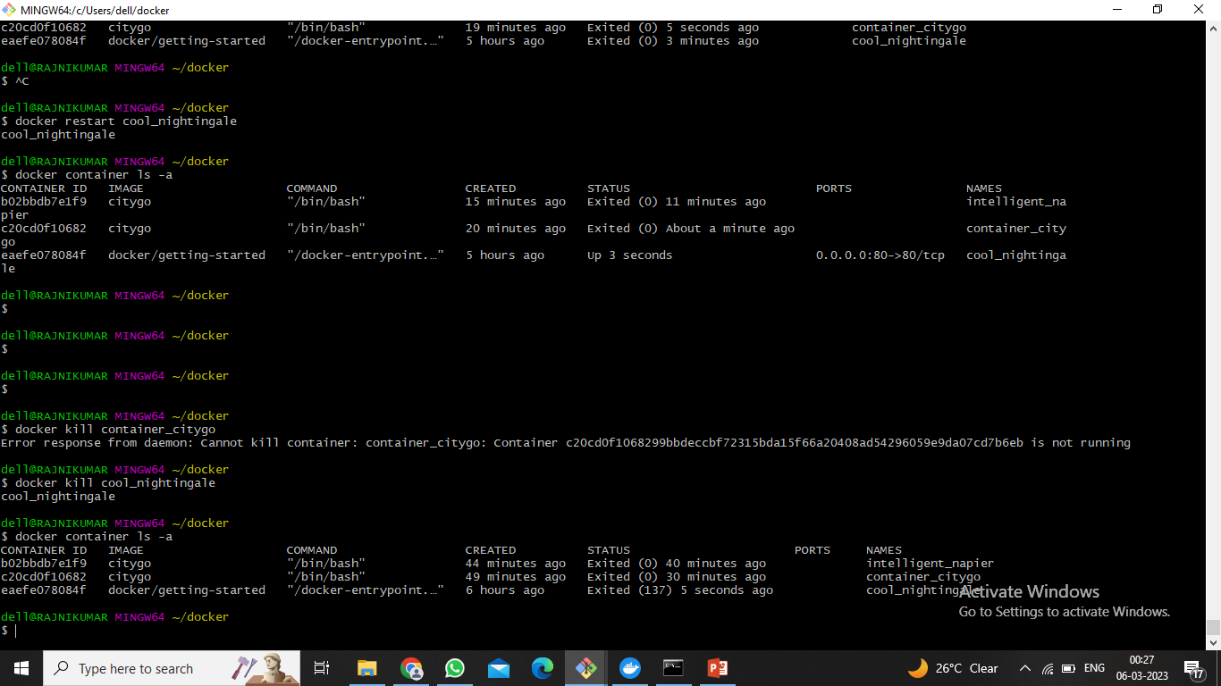
Kill a running container

Slide 65
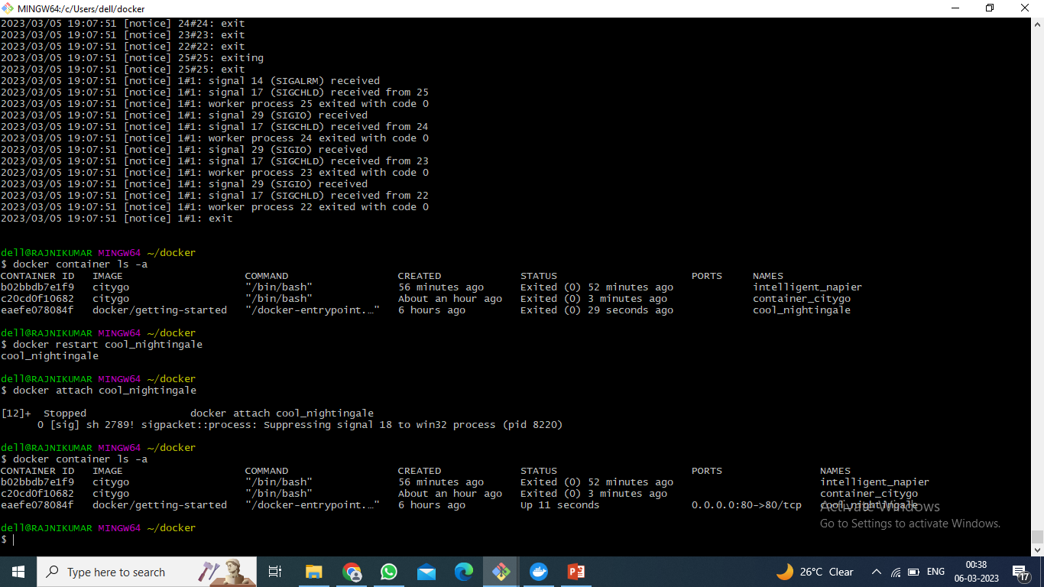
Attach local standard input and output

Slide 66
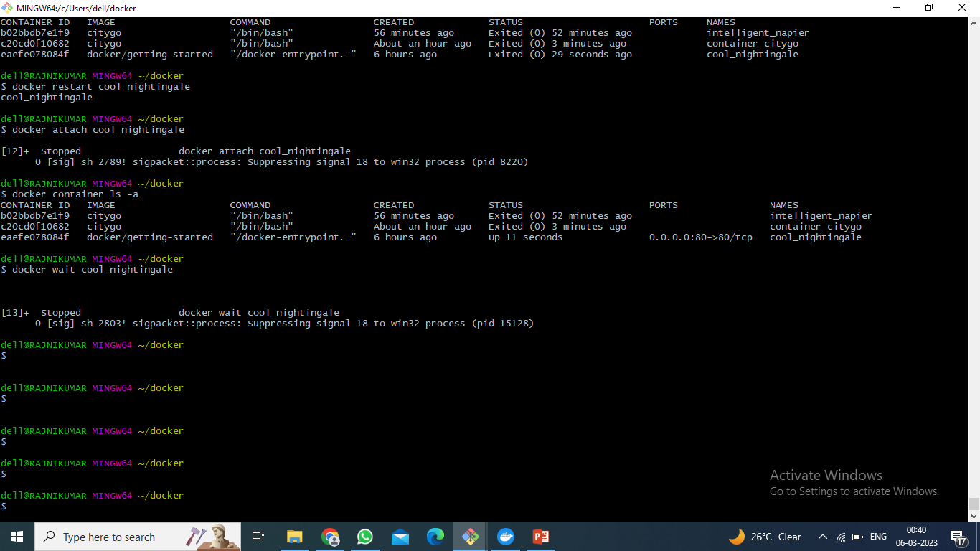
Block Container

Slide 67
Docker Share Command

Slide 68
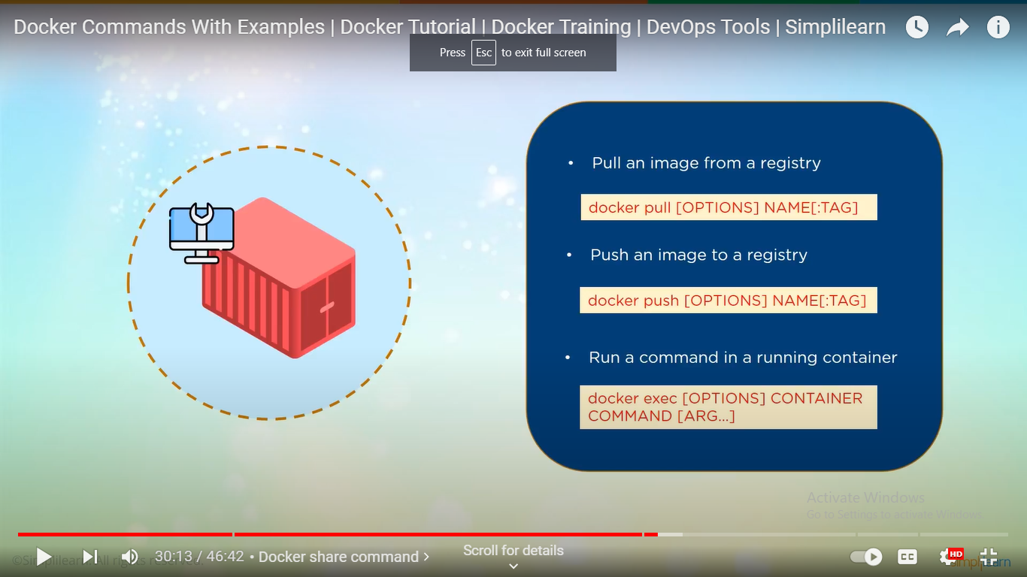


Pull an image from a registry

Slide 69

Need to login before push

Slide 70

Push an image to a registry

Slide 71

Push an image to a registry
Re-tag image with user name

Slide 72

Push an image to a registry

Slide 73

Run a Command in a running container

Slide 74

Get information of Docker tool

Slide 75

Display History of Image

Slide 76
AGENDA
What is Kubernetes?
Architecture of Kubernetes
Benefit of K8s

Slide 77
What is Kubernetes?
An open-source and more than container orchestration system
For automating software deployment, scaling, and management
Originally developed by Google
helps us to manage applications
made up of hundreds or maybe thousands of containers
helps us to manage them in different environments

Slide 78
Architecture of Kubernetes

Slide 79

KUBERNETS ARCHITECHURE
The entire Kubernetes architecture revolves around the concept of the cluster. A cluster is a set of nodes, physical or virtual machines that perform various functions. Each cluster consists of:
The control plane
Worker nodes

Slide 80





User
Cluster
Control Plane
Worker Node
etcd
Key-value
Kube-proxy
POD
container
Controller manager
API SERVER
Kublet
POD
Action
Scheduler
Container
Engine
Developer

Slide 81
User
Cluster
Control Plane
Worker Node
etcd
Key-value
Kube-proxy
POD
container
Controller manager
API SERVER
Kublet
POD
Action
Scheduler
Container
Engine
Kubectl(CLI)
Developer

Slide 82

KUBERNETS ARCHITECHURE

Slide 83
IMPORTANT TERMS
The control plane has four primary components used to control communications, manage nodes and keep track of the state of a Kubernetes cluster.
Kube-apiserver. As its name suggests, the kube-apiserver exposes the Kubernetes API.
etcd. A key-value store where all data relating to the Kubernetes cluster is stored.
Kube-scheduler. Watches for new Kubernetes Pods with no assigned nodes and assigns them to a node for execution based on resources, policies, and ‘affinity’ specifications.
Kube-controller-manager. All controller functions of the control plane are compiled into a single binary: kube-controller-manager.

Slide 84
Kubernetes Benefits
Automated Scheduling
Self Healing Capabilities
Automated rollouts & rollback
Horizontal Scaling & Load Balancing

Slide 85


Slide 87


Slide 89
AGENDA
What we study previous ? Minikube & it’s architecture
Steps for Installation
Commands

Slide 90

What will you need ?

Slide 91

We already see how to install docker .
https://docs.docker.com/desktop/install/windows-install/

Slide 92

Command for docker install

Slide 93

Now let’s install Minikube
Website direct link : https://minikube.sigs.k8s.io/docs/start/

Slide 94
Second way from command line
Download and run using PowerShell, use this command:
Step 1 : Install from github
New-Item –Path 'c:\' -Name 'minikube' -ItemType Directory -Force
Invoke-WebRequest –OutFile 'c:\minikube\minikube.exe' -Uri 'https://github.com/kubernetes/minikube/releases/latest/download/minikube-windows-amd64.exe' -UseBasicParsing
Step 2: setup path
Add the minikube.exe binary to your PATH.
Make sure to run PowerShell as Administrator.

Slide 95


Slide 96
After download Minikube
Use Command :-
1) Minikube start
2) Minikube status
3) kubectl get all

Slide 97

1)Minikube start : start the Minikube

Slide 98

2)Minikube status : check the status

Slide 99
3)Kubectl get all : It display all the services running in our cluster.

Slide 100
1)Let’s download Kubectl
The Kubernetes command-line tool, kubectl, allows you to run commands against Kubernetes clusters.
You can use kubectl to deploy applications, inspect and manage cluster resources, and view logs.

Slide 101


Slide 102


Slide 103
Kubernetes commands
Cluster Management
Deployments
Daemonsets

Slide 104

1) Cluster Management

Slide 105

1) Cluster Management

Slide 106

1) Cluster Management

Slide 107

2) Daemonsets
A DaemonSet ensures that all (or some) Nodes run a copy of a Pod. As nodes are added to the cluster, Pods are added to them.
As nodes are removed from the cluster, those Pods are garbage collected.
Deleting a DaemonSet will clean up the Pods it created.

Slide 108

2) Daemonsets

Slide 109

2) Daemonsets

Slide 110

2) Daemonsets

Slide 111

3)Deployment : A Kubernetes Deployment tells Kubernetes how to create or modify instances of the pods that hold a containerized application.

Slide 112

3) Deployments

Slide 113

3) Deployments

Slide 114
AGENDA
Deployment Minikube and kubectl
Deploy web page.

Slide 115
STEPS
Install Minikube , kubectl and docker
Start Minikube using command
Create docker image and pods
Deploy on docker site and on Minikube dashboard(local host)

Slide 116



Slide 117

What we want to deploy ? We can deploy html web site to the Minikube dashboard and docker.

Slide 118

Start cluster
Minikube start

Slide 119
File we want for a deployment
Source code files (index file , read me file ) – our project file
Python (webapp.py) file to connect to the server.
Docker image file
Jason file or Yaml file

Slide 120

Webapp.py file for a connect to the server

Slide 121
Check webapp.py file is working or not

Slide 122
STEPS
Install Minikube , kubectl and docker ☑
Start Minikube using command ☑
Create docker image and pods
Deploy on docker site and on Minikube dashboard(local host)

Slide 123


Slide 124

Use command docker build to create a docker file

Slide 125

Create pod Using Json/Yaml file

Slide 126


Check our pod is created or not using command

Slide 127
STEPS
Install Minikube , kubectl and docker ☑
Start Minikube using command ☑
Create docker image and pods ☑
Deploy on docker site
Login into docker
Push docker image

Slide 128

Login into docker site

Slide 129

Push image into docker site
Push our image on https://hub.docker.com/repository/docker/jay1820/collegesite/general
Create docker repository for a project

Slide 130

Push docker image on docker site

Slide 131

Push docker image on docker site

Slide 132

Pull docker image from other account pc

Slide 133
STEPS
Install Minikube , kubectl and docker ☑
Start Minikube using command ☑
Create docker image and pods ☑
Deploy on docker site ☑
Login into docker ☑
Push docker image ☑
Deploy on Minikube dashboard localhost

Slide 134

Deployment on localhost Minikube
STEPS:-
1)Minikube kubectl get pods 2)kubectl – gets deploy http-server –o Yaml 3)Minikube dashboard

Slide 135

2)kubectl – gets deploy http-server –o yaml
1)

Slide 136

3) Use command – Minikube dashboard

Slide 137

4)Finally run on localhost

Slide 138

Thank You!

